Slide 1


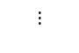



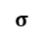
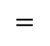



Generator
Fake
Conv.
Real or fake
noise z
char class
Discriminator
4×4
256
100
26
G
ç
D/C
Concat μ
(Reshaped)
char classification
Real
FC layer
impression classification
Reshape
Fake
Target Style
Style Consistency
Discriminator
word2vec
vectors
Real
0.05
0.03
0.34
0.00
0.02
0.19
300 dim.
semantic
condition
linear
μ
happy
$$⨁$$
thick
$$∑$$
+
SCD
consistency classification
$$⨀$$
decoratie
$$=$$
big
$$σ$$
funny
$$⋮$$
$$⋮$$
$$⊗$$
Diff.
shade
noise
Notes:
・そこでPGGANをベースとしてこのようなアーキテクチャのモデルを構築しました．
先ほど説明したimpressions2fontを異なる点は3つありまして，一つ目はprogressiveな層構造をGenerator, Discriminatorともに導入しました．
二つ目は, 印象の埋め込み表現をDiscriminatorにも与えるということです．３つ目は，conditioning audumentationと呼ばれる手法なんですけども，このように学習に使用する印象の埋め込み表現に確率的な要素を加えるということです．このようにしてノイズを与えることで，同じ印象からでもより多様性のあるフォントを生成することを可能とします．

Slide 2

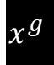
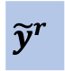
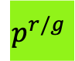
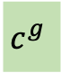
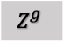
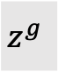
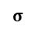
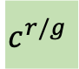
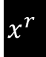
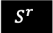
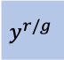
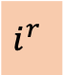
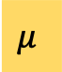
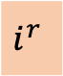
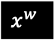
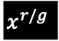
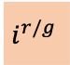
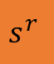
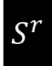
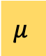
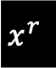
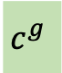
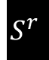
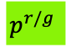

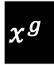
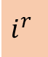

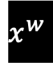
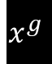
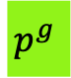
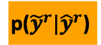
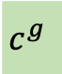
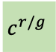


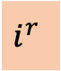
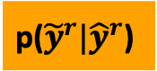
$$s^{r}$$
semantic cond.
$$y^{r/g}$$
impression-class cond.
$$x^{r/g}$$
real / fake image
IE
G
D/C
SCD
$$i^{r/g}$$
impression-prob. cond.
$$c^{r/g}$$
char-class cond.
$$x^{w}$$
wrong real image
Progressive
Discriminator
+ aux. classifier
internal conditions
external conditions
$$S^{r}$$
stacked style images
impression
embedding
Progressive
Generator
Style Consistency
Discriminator
$$Z^{g}$$
noise
$$\text{p}\text{(}{\tilde{y}}^{r}|{\hat{y}}^{r}\text{)}$$
co-occurrence matrix
$$p^{r/g}$$
char-class prob.
KL Div.
BCE
Training Step
Discriminator
$$μ$$
real/fake
Conv.
$$p^{r/g}$$
$$c^{r/g}$$
$$x^{w}$$
or
$$x^{g}$$
or
$$x^{r}$$
$$x^{g}$$
or
$$x^{r}$$
D/C
SCD
correct / incorrect
train
$$i^{r}$$
$${\hat{y}}^{r}$$
$$\text{p}\text{(}{\tilde{y}}^{r}|{\hat{y}}^{r}\text{)}$$
$${\tilde{y}}^{r}$$
$S^{r}$
train
impression label
space compression
Missing label estimation
by label occurrence
Training Step
Generator
$$μ$$
real/fake
$$c^{g}$$
$$c^{g}$$
Conv.
$$p^{g}$$
$$c^{g}$$
$$x^{g}$$
$$z^{g}$$
G
$$x^{g}$$
D/C
SCD
correct / incorrect
μ
train
linear
$$⨁$$
train
fix
$$i^{r}$$
$$i^{r}$$
$$S^{r}$$
fix
$$i^{r}$$
IE
$$s^{r}$$
$$σ$$
impression label
space compression
$$⊗$$
noise

Slide 4



cattle-drive
headline, compress, condense, serif, retro, western, display, slab-serif
abdominal-krunch
decorative, graphic, eccentric, novelty, polygonal, handwrite, comic
sorbonne
antique, decorative, incunabula, legible,
funny, french, display, humanistic, round

Slide 5




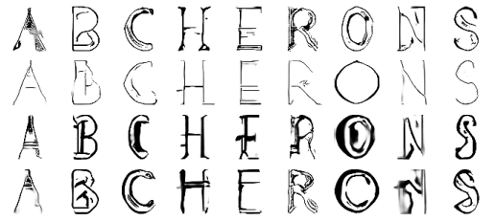
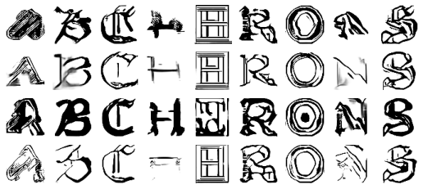
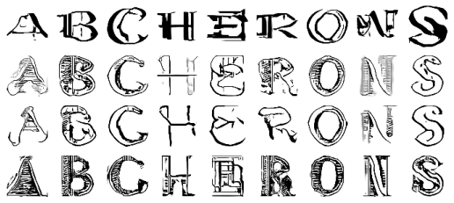

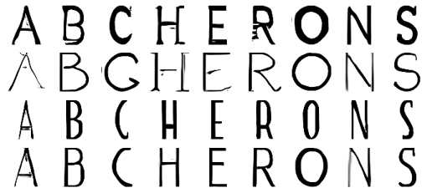

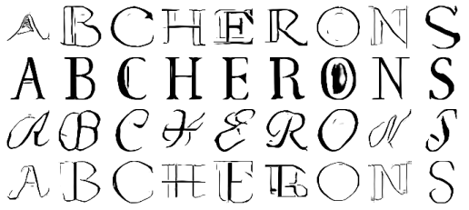

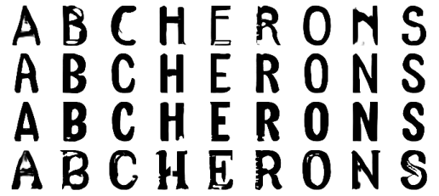

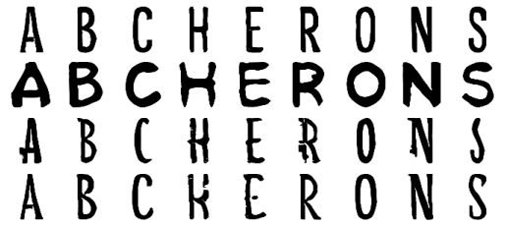

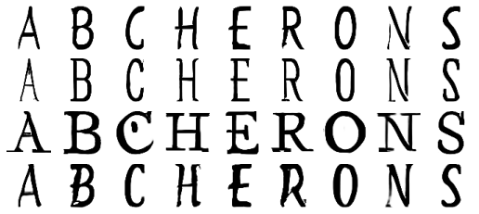
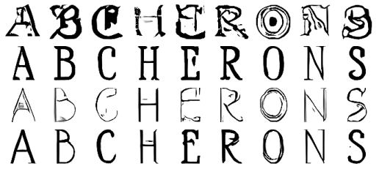
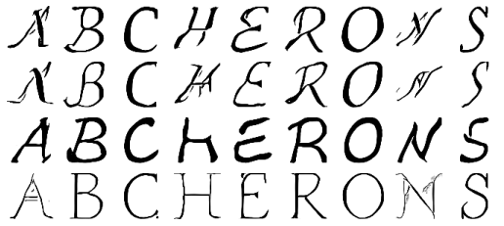

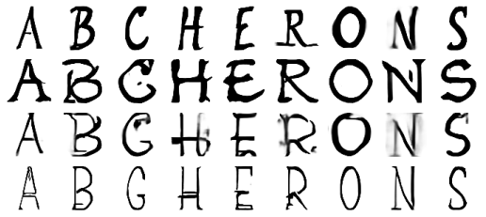

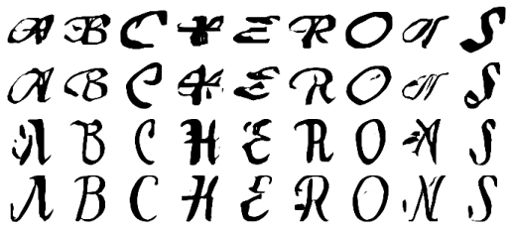
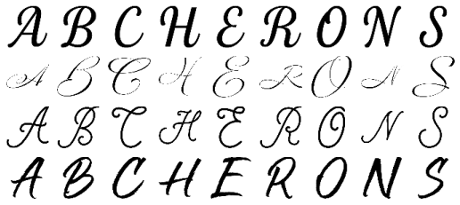








単一印象
w/o MLEO
w/o ILSC
Full model
Real images
w/o MLEO
w/o ILSC
Full model
Real images
normal
shade
italic
scary
handwrite
vintage
horror
text

Slide 6
























w/o MLEO
w/o ILSC
Full model
Real images
複数印象
narrow, ancient
bitmap, pixel
bitmap, pixel
cosmetic, young
3d, shadow
heavy
horror
traditional
comic
Imp2Font
Full model

Slide 7































Real images
Full model
w/o MLEO
w/o ILSC
Imp2Font
CP-GAN+
AC-GAN+
C-GAN+
shade
vintage
handwrite
horror
fat
narrow,
ancient
3d,
shadow

Slide 8
Real images
Full model
w/o CMLE
w/o ILSC
Imp2Font
vintage
handwrite
horror
fat
narrow
+
ancient
3d
+
shadow

Slide 9















線形補間
thin
retro
serif
word1
$$λ=0$$
$$λ=0.2$$
$$λ=0.4$$
$$λ=0.6$$
$$λ=0.8$$
word2
$$λ=1.0$$
thick
modern
sans-serif
legible
luxury
antique
noise1
$$λ=0$$
$$λ=0.2$$
$$λ=0.4$$
$$λ=0.6$$
$$λ=0.8$$
noise2
$$λ=1.0$$

Slide 10













draw, grunge, surf, surfer, brush, handwrite etc...
alternate, girly, natural,
ribbon, elegant, rough etc...
extreme, line, edgy, inline,
tube, rough, ink etc...
full
$$100$$
w/o MLEO
$$80$$
$$60$$
$$40$$
missing
$$20$$
full
$$100$$
$$80$$
w/o ILSC
$$60$$
$$40$$
missing
$$20$$
full
$$100$$
$$80$$
Full model
$$60$$
$$40$$
missing
$$20$$

Slide 11
high dimension
low dimension
close
far
serif
text
shade

Slide 12



Slide 13
ラベル圧縮の説明
K
high dimension
low dimension
D/C
classify
impression
baseline
（binary relevance）
K
n
D/C
classify
impression
Impression label space compression

Slide 14






Larger is better
Larger is better
Smaller is better
Full model
Full model
Full model
Full model
Full model
w/o MLEO
w/o MLEO
w/o MLEO
Larger is better
Larger is better
Smaller is better
Full model
Full model
Full model
w/o ILSC
w/o ILSC
w/o ILSC
(a) mAP-train
(b) mAP-test
(c) Intra-FID

Slide 15




Full model
Full model
Full model
Imp2Font
Imp2Font
Imp2Font
(a) GAN-train
(b) GAN-test
(c) Intra-FID
1.8
Full model
1.6
w/o ILSC
mAP-test
1.4
w/o CMLE
1.2
Imp2font
1.0
10
20
30
40
50
60
70
80
Impression Missing Ratio (%)

Slide 16


mAP-train (%)
Full model
w/o ILSC
w/o CMLE
Impression label ranking by frequency

Slide 17

mAP-test (%)
Full model
w/o ILSC
w/o CMLE
Impression label ranking by frequency

Slide 18
印象語の増加に伴うmAP-trainの推移
mAP-train (%)
Full model
w/o CMLE
w/o ILSC
Impression label ranking by frequency

Slide 19

印象語の増加に伴うmAP-testの推移
mAP-test (%)
Full model
w/o CMLE
w/o ILSC
Impression label ranking by frequency

Slide 20

印象語の頻度とAP-trainの関係性
AP-train (%)
w/o ILSC
w/o CMLE
Full model
Impression label ranking by frequency

Slide 21

印象語の頻度とAP-testの関係性
AP-test (%)
Full model
w/o CMLE
w/o ILSC
Impression label ranking by frequency

Slide 22

AP-test
AP (%)
label frequency
AP-train
label frequency
Impression label ranking by frequency

